Slide 1
Oracle Advanced & New Features SQL

Slide 2
SQL Developer New Features
DBA Views
Report Views
Data Model Views
Git Support
PLSQL Debugging
PLSQL Unit Testing

Slide 3
Inline Subquery and Function

Slide 4
Oracle SQL Regular Expressions
REGEXP_LIKE
Condition that can appear in the WHERE clause of a query, causing the query to return rows that match the given pattern.
REGEXP_INSTR
Indicates the starting position of the given pattern in the given string. Alternatively, the integer can indicate the position immediately following the end of the pattern.

Slide 5
Oracle SQL Regular Expressions
REGEXP_REPLACE
Replacing occurrences of the given pattern in the given string with a replacement string.
REGEXP_SUBSTR
Returns the matching substring itself.

Slide 6
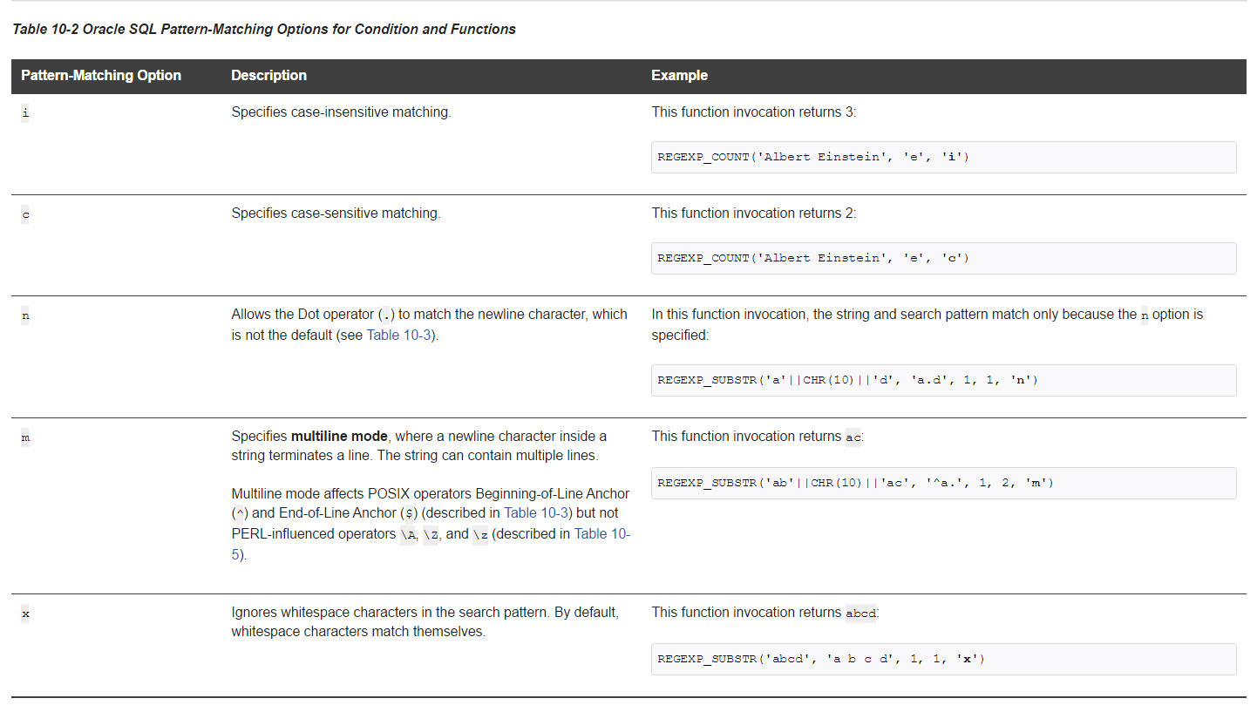
Posix Operators
Oracle SQL PERL-Influenced Extensions to POSIX Standard

Slide 7
Using Oracle Flashback Technology
Overview of Oracle Flashback Technology
Configuring Your Database for Oracle Flashback Technology
Using Oracle Flashback Query (SELECT AS OF)
Using Oracle Flashback Version Query
Using Oracle Flashback Transaction Query
Using Oracle Flashback Transaction Query with Oracle Flashback Version Query
Using DBMS_FLASHBACK Package
Using Flashback Transaction
Using Flashback Data Archive
General Guidelines for Oracle Flashback Technology
Performance Guidelines for Oracle Flashback Technology
Multitenant Container Database Restrictions for Oracle Flashback Technology

Slide 8
Maintain Data in Different Timezones
Configures Session Time Zone
Alter session set time_zone=‘-5:00’ <- EST
Alter session set time_zone=dbtimezone
Alter session set time_zone=local
Alter session set time_zone=‘America/New _York’

Slide 9
Functions Returning Date and Time
SysDate -> returns Server based [Date] data
SysTimeStamp -> returns Server based [Timestamp with TimeZone] data
Current_Date -> returns session based [Date] data
Current_Timestamp -> returns session based [Timestamp with TimeZone] data
LocalTimestamp -> returns session based [Timestamp] data

Slide 10
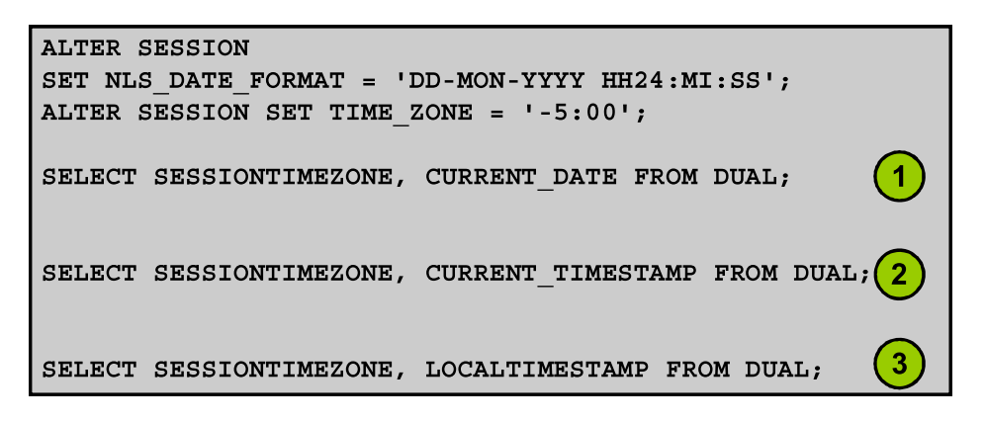
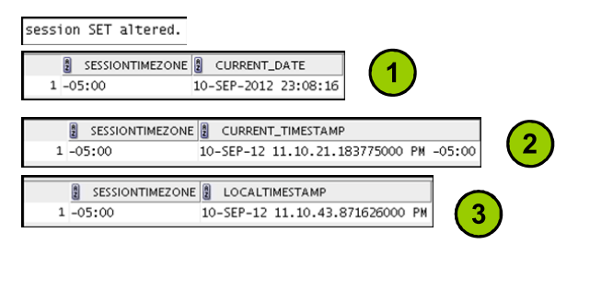

Slide 11
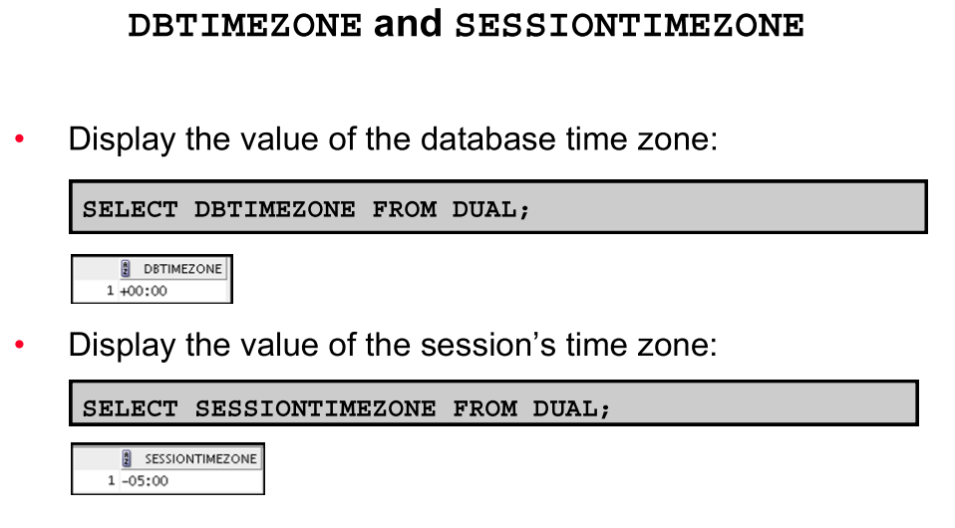

Slide 12
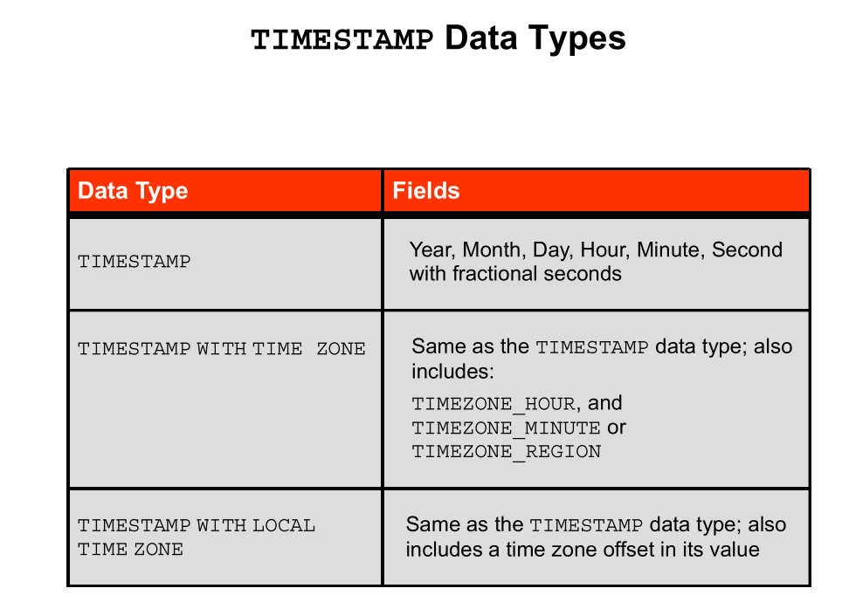
Notes:
The TIMESTAMP data type is an extension of the DATE data type. TIMESTAMP (fractional_seconds_ precision)
This data type contains the year, month, and day values of date, as well as hour, minute, and second values of time, where significant fractional seconds precision is the number of digits in the fractional part of the SECOND datetime field. The accepted values of significant fractional_seconds_precision are 0 through 9. The default is 6. TIMESTAMP (fractional_seconds_precision) WITH TIME ZONE
This data type contains all values of TIMESTAMP as well as time zone displacement value. TIMESTAMP (fractional_seconds_precision) WITH LOCAL TIME ZONE
This data type contains all values of TIMESTAMP, with the following exceptions: • Data is normalized to the database time zone when it is stored in the database. • When the data is retrieved, users see the data in the session time zone.

Slide 13
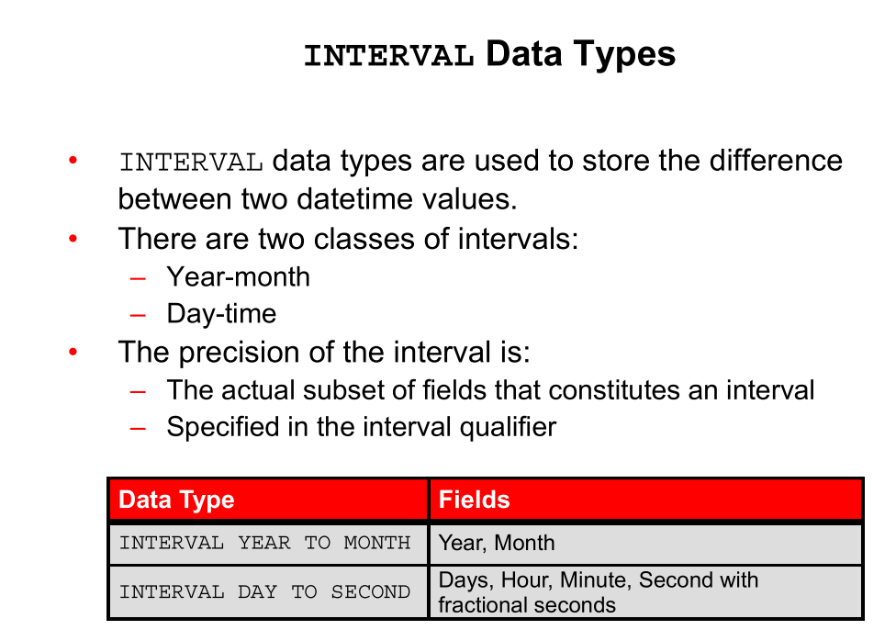

Slide 14
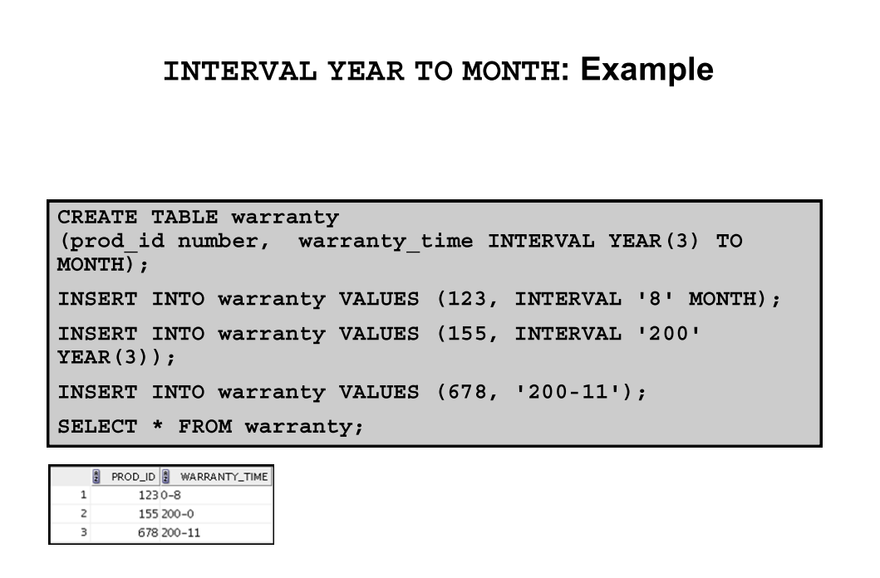

Slide 15
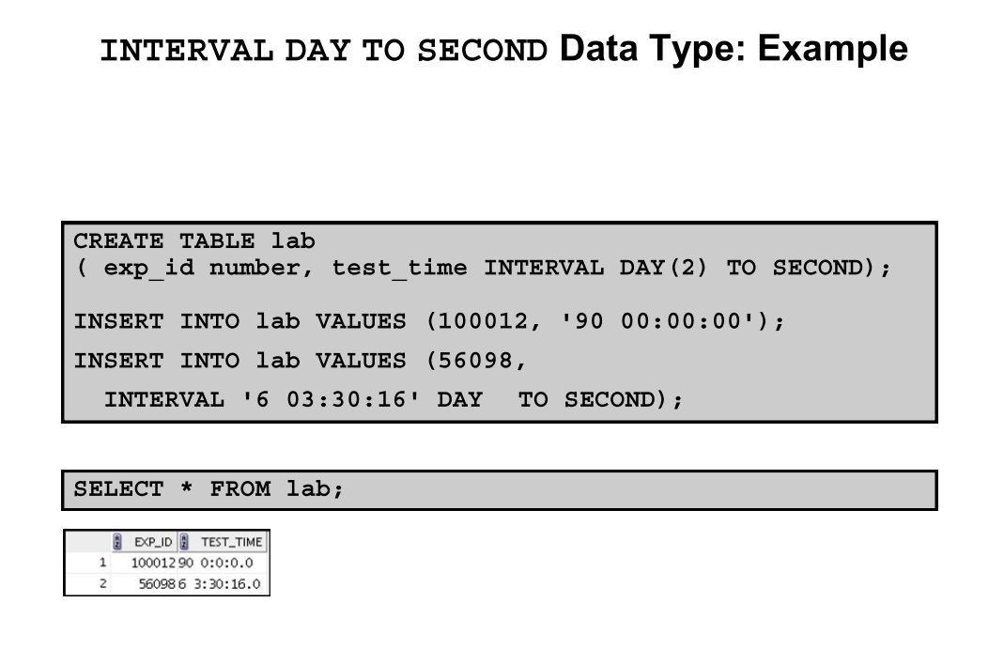

Slide 16
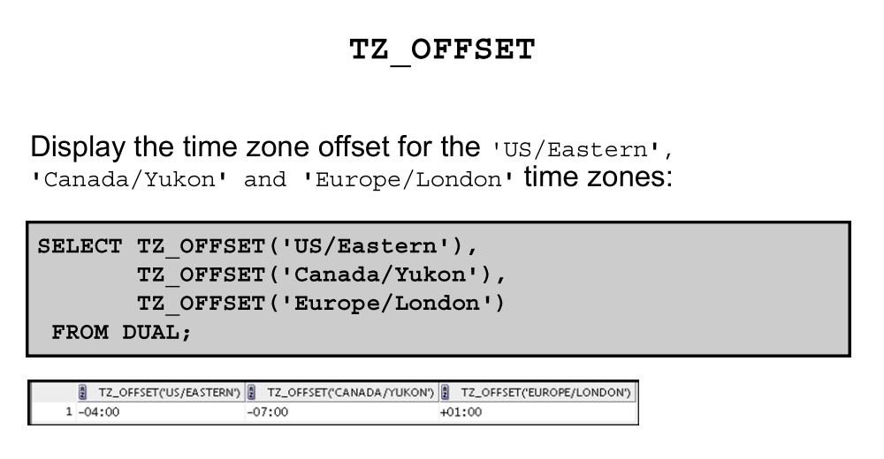

Slide 17
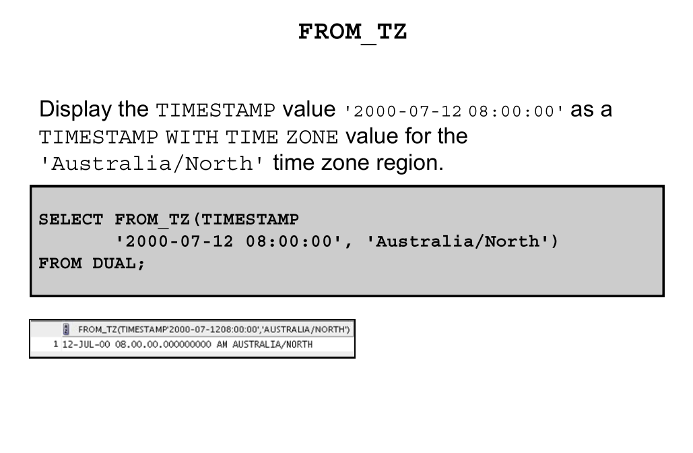

Slide 18
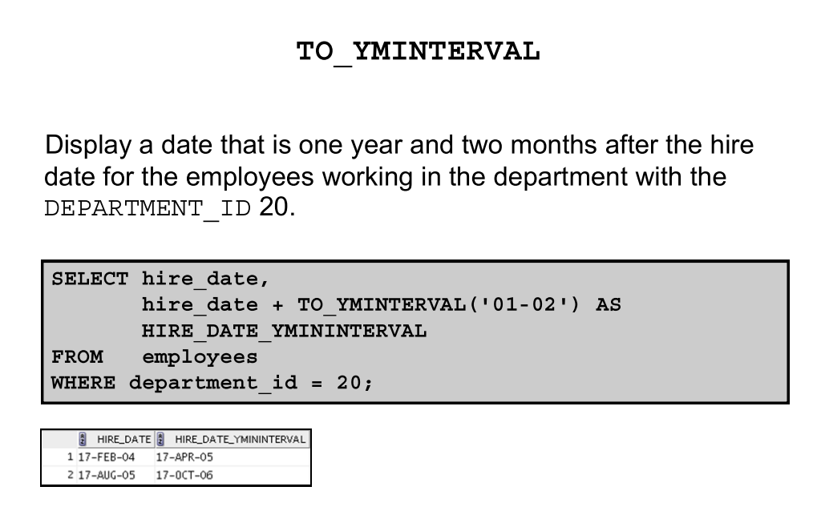

Slide 19
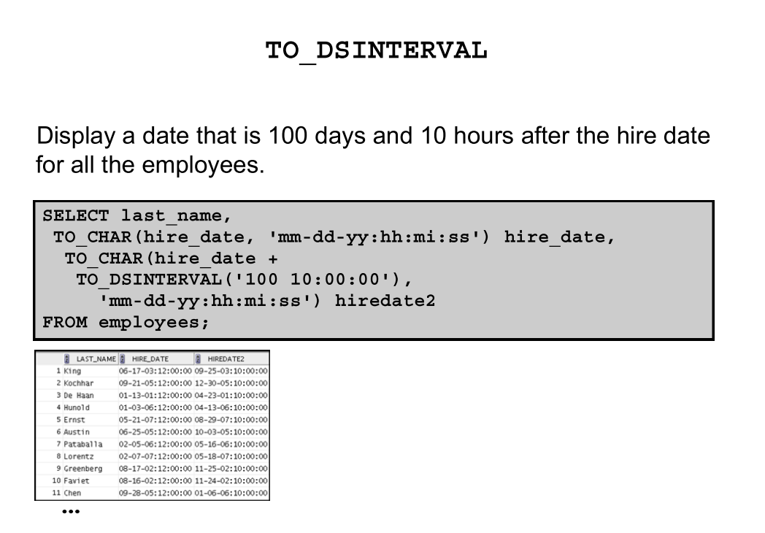

Slide 20
Multi-Table Insert and Merge

Slide 21
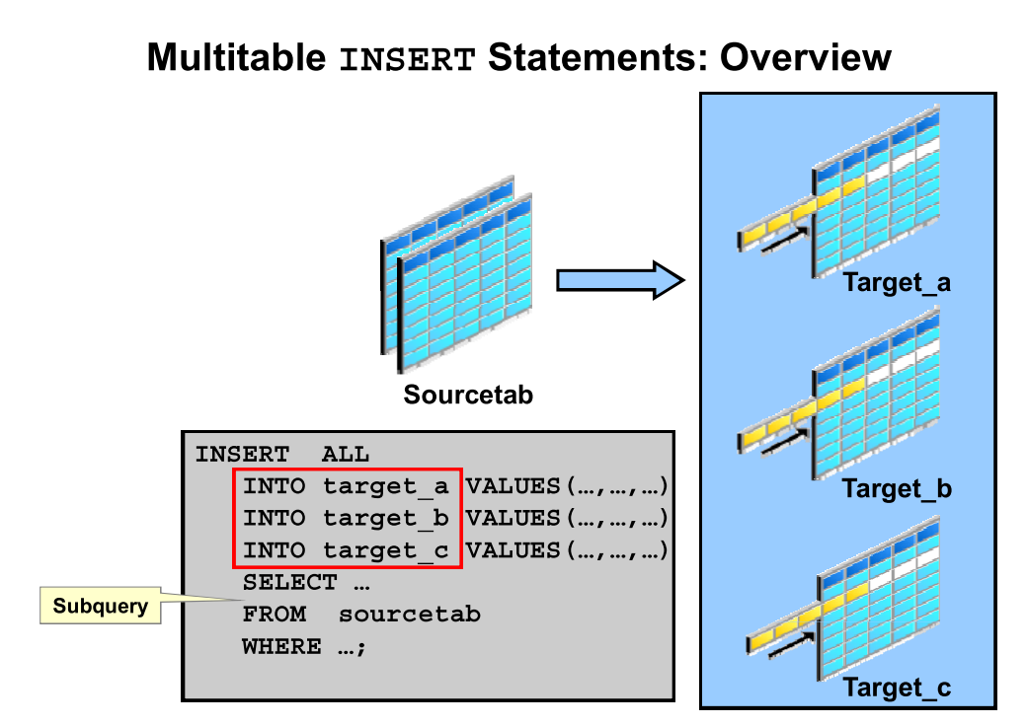

Slide 22
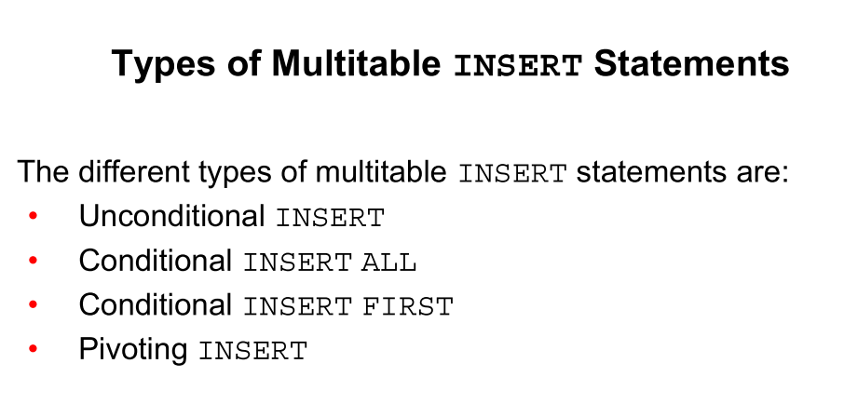
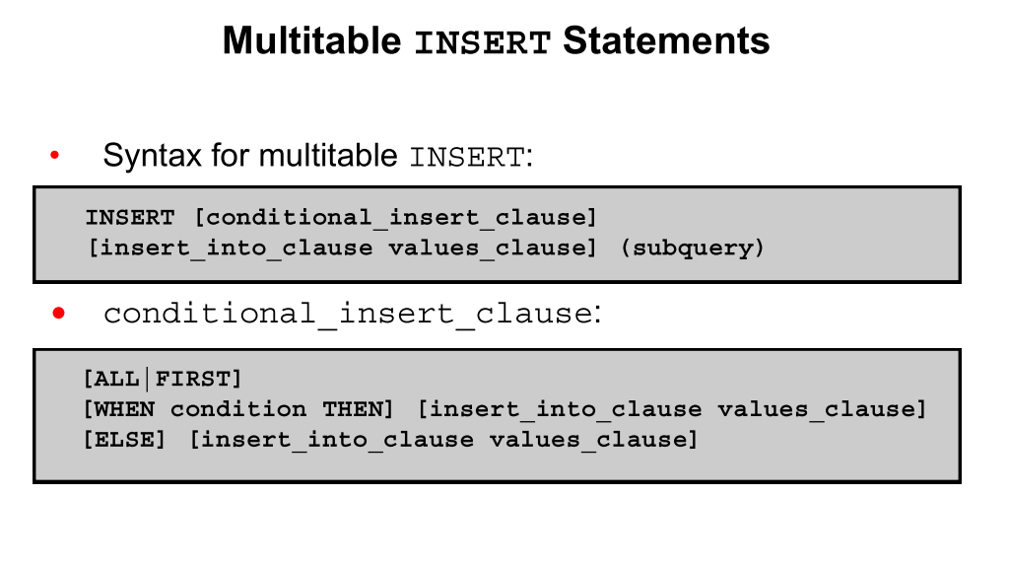

Slide 23
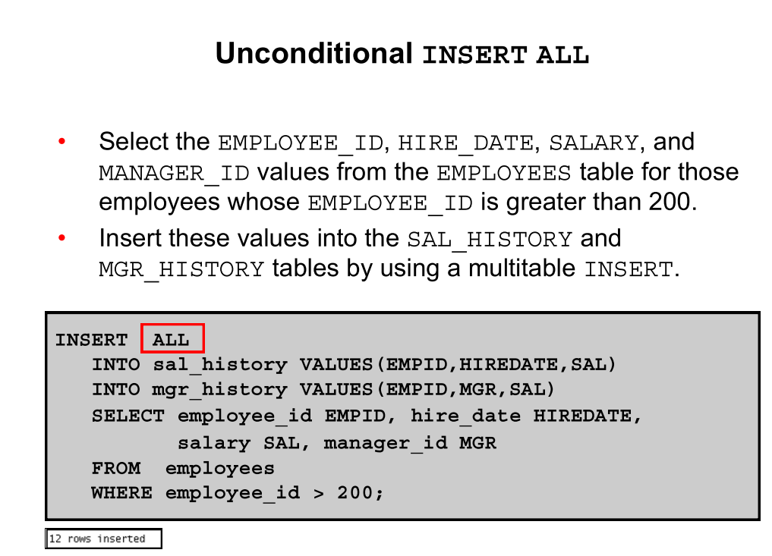

Slide 24
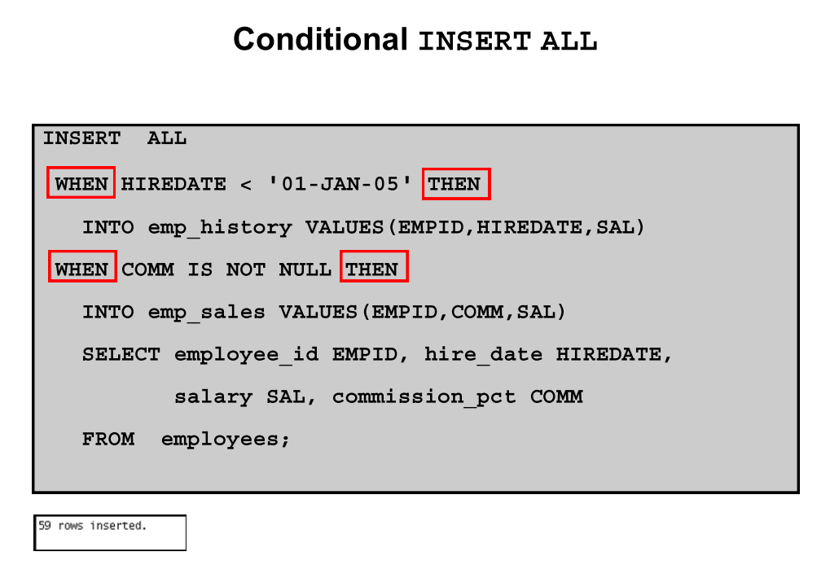

Slide 25
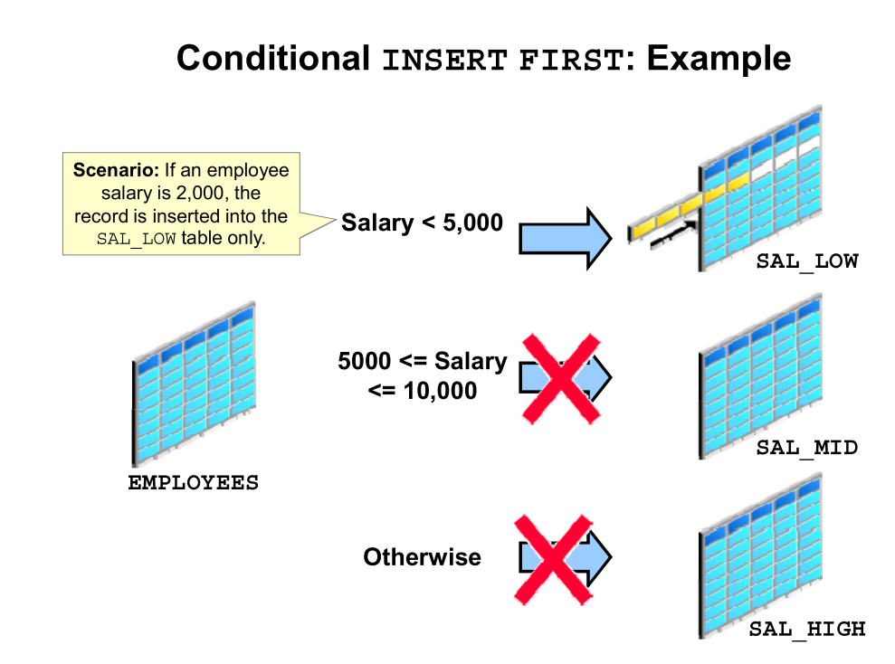
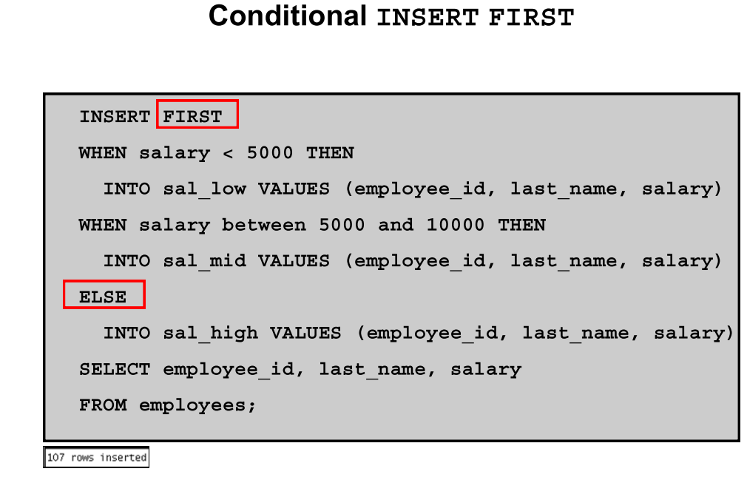

Slide 26
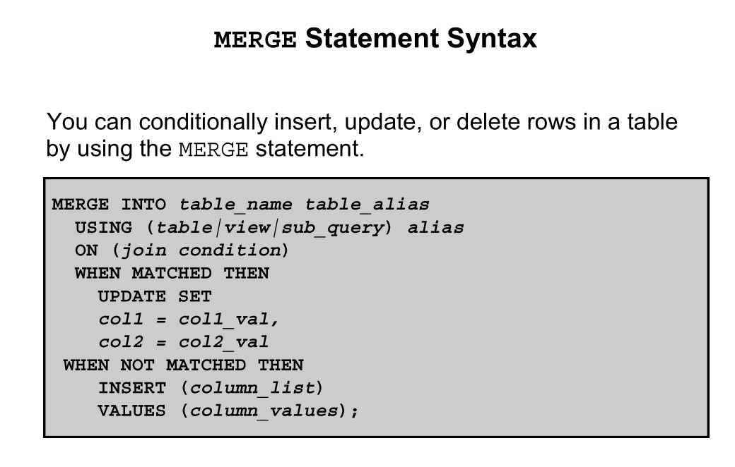

Slide 27
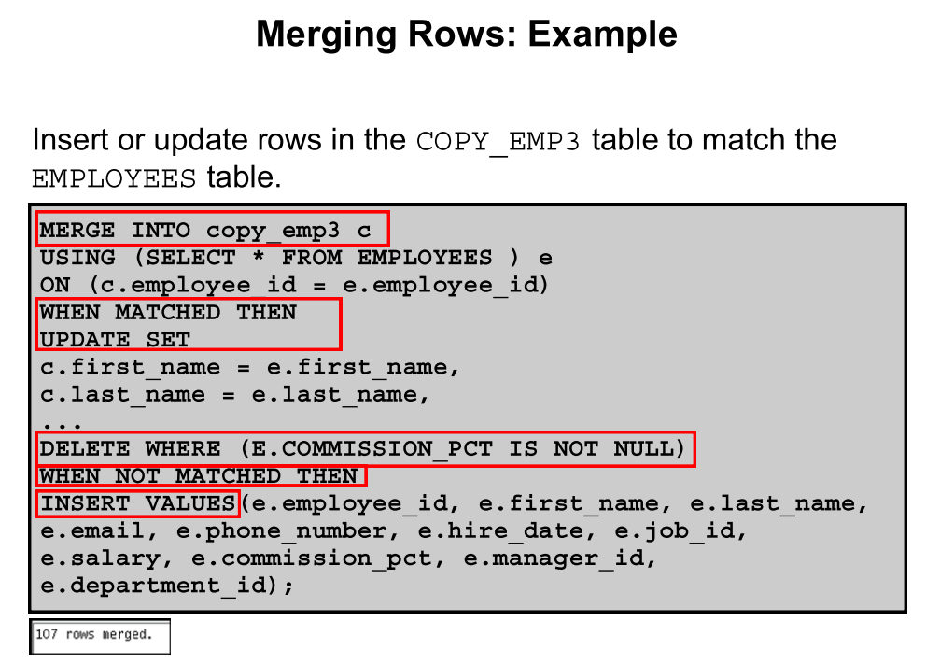

Slide 28
Hierarchical Query Operators
PRIOR
CONNECT_BY_ROOT

Slide 29
Expression Lists
SELECT * FROM employees
WHERE (first_name, last_name, email) IN
(('Guy', 'Himuro', 'GHIMURO'),('Karen', 'Colmenares', 'KCOLMENA'))

Slide 30
Grouping sets
SELECT
prod_category, prod_subcategory, country_id, cust_city, count(*)
FROM products, sales, customers
WHERE sales.prod_id = products.prod_id
AND sales.cust_id=customers.cust_id
AND sales.time_id = '01-oct-00'
AND customers.cust_year_of_birth BETWEEN 1960 and 1970
GROUP BY GROUPING SETS
(
(prod_category, prod_subcategory, country_id, cust_city),
(prod_category, prod_subcategory, country_id),
(prod_category, prod_subcategory),
country_id
)

Slide 31
12c SQL New Feature

Slide 32
Identity Column
/*Create a table for demonstration purpose*/ CREATE TABLE t_id_col (id NUMBER GENERATED AS IDENTITY, name VARCHAR2(20)) /
While inserting data in the table T_ID_COL, do not include the identity column as its value is automatically generated
INSERT INTO t_id_col VALUES (7,'Steyn'); insert into t_id_col values (7,'Steyn') * ERROR at line 1: ORA-32795: cannot insert into a generated always identity column

Slide 33
Default column value to a sequence
CREATE SEQUENCE seq START WITH 100 INCREMENT BY 10
//*Create a table with a column defaulted to the sequence value*/
CREATE TABLE t_def_cols ( id number default seq.nextval primary key,
name varchar2(30),
doj date default on null '01-Jan-2000' ) /

Slide 34
Support for 32K VARCHAR2
The feature can be controlled using the initialization parameter MAX_STRING_SIZE. It accepts two values:
STANDARD (default)—The maximum size prior to the release of Oracle Database 12c will apply.
EXTENDED—The new size limit for string datatypes apply. Note that, after the parameter is set to EXTENDED, the setting cannot be rolled back.

Slide 35
Row Limiting Query
SELECT * FROM t_fetch_first ORDER BY sal DESC FETCH FIRST 5 ROWS ONLY
/*Query to list top-25% employees by hiredate*/ SELECT * FROM t_fetch_first ORDER BY hiredate FETCH FIRST 25 PERCENT ROW ONLY
/*Query to list 2 employees after skipping first 5 employees*/ SELECT * FROM t_fetch_first ORDER BY SAL DESC OFFSET 5 ROWS FETCH NEXT 2 ROWS ONLY /

Slide 36
Temporal Validity Table
/*Create table with valid time temporal*/
CREATE TABLE t_tmp_db(
id NUMBER,
name VARCHAR2(30),
policy_no VARCHAR2(50),
policy_term number,
pol_st_date date, pol_end_date date,
PERIOD FOR pol_valid_time (pol_st_date, pol_end_date)) /
/* Alter existing Table to support Temporal Validity */
alter table hr.emp_temp add period for valid_time;

Slide 37
AS OF PERIOD AND PERIOD FOR
select first_name, to_char(valid_time_start,'dd-mon-yyyy') "Start", to_char(valid_time_end,'dd-mon-yyyy') "End" from hr.emp_temp as of period for valid_time to_date('01-JUN-2011') order by 2;
select first_name, to_char(valid_time_start,'dd-mon-yyyy') "Start", to_char(valid_time_end,'dd-mon-yyyy') "End" from hr.emp_temp versions period for valid_time between to_date('01-SEP-1995') and to_date('01-SEP-1996') order by 2

